Slide 1
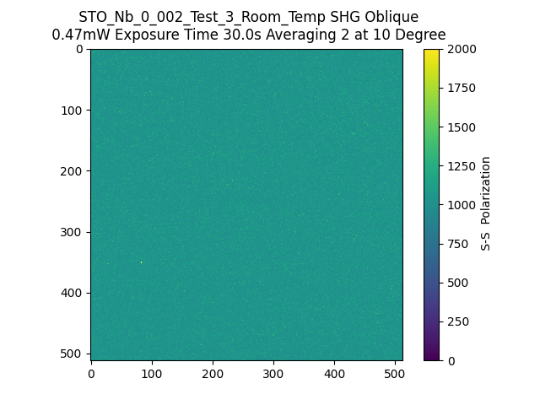
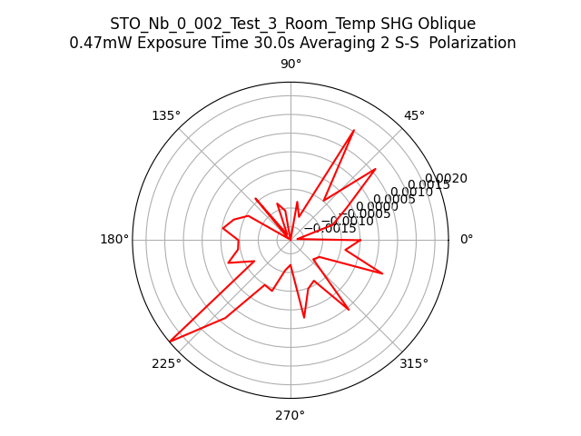
144413_STO_Nb_0_002_Test_3_Room_Temp_SHG_Oblique_SS

